Slide 1
Ride BOOKING SYSTEM GROUP 6

Slide 2
AGENDA
Problem statement, solution and project overview
Abstract
Objectives
System specifications
ER Diagram
Key features and functionalities
Results

Slide 3
Problem Statement and Solution
Problem Statement
Managing a ride-booking platform involves challenges in ensuring seamless interactions between admins, drivers, and riders. Key issues include the efficient allocation of earnings, transparent ride management, and reliable processes for payments and cancellations. Furthermore, providing user-friendly dashboards and ensuring trust across all roles are critical for smooth operations.
Solution
Develop a comprehensive ride-booking platform with distinct functionalities for Admins, Drivers, and Riders. Admins monitor system efficiency, manage payments, and earn a 20% commission per booking. Drivers handle ride creation, track bookings, and manage earnings through dedicated dashboards. Riders access nearby rides, make secure payments, and track trip details. Automated processes ensure transparency, including refunds for cancellations, fostering reliability and trust among users. Project Overview: Ride-Booking Platform
This project focuses on developing a robust and user-friendly ride-booking platform, facilitating seamless interaction between Admins, Drivers, and Riders while ensuring operational efficiency, financial transparency, and excellent user experience. The platform incorporates functionalities for user registration, ride creation, booking, payment processing, and refund management.

Slide 4
ABSTRACT
This project outlines the development and operation of a ride-booking platform designed to facilitate efficient transportation for riders while offering income opportunities for drivers. The system integrates three key roles: Admin, Driver, and Rider, each with distinct responsibilities and functionalities.
The Admin oversees the platform's operations, managing payments, ensuring seamless transaction processes, and monitoring system performance through comprehensive dashboards. Admins earn a 20% commission on each booking and are pivotal in maintaining platform efficiency.
The Driver role focuses on creating and managing rides. Drivers register by providing personal and vehicle details, post trip schedules, and manage bookings and earnings via their dashboard. They retain 80% of the fare and can cancel rides when necessary, triggering automated refund processes for riders.
The Rider role caters to customers, allowing them to search for and book rides within a 2–5-mile radius. Riders register on the platform, make secure payments via card, and track trip details through personalized dashboards. In cases of cancellations by drivers, riders receive refunds seamlessly.
This project ensures a user-friendly and transparent system, promoting trust and convenience for all stakeholders while streamlining ride-booking services.

Slide 5
OBJECTIVES
The primary objective of a ride booking platform is to provide users with a convenient and accessible way to book transportation by connecting them with available drivers. User Experience: Ensure a smooth and intuitive interface for both riders and drivers. The goal is to make booking a ride as effortless as possible. Facilitate Secure Transactions: Ensure payments are processed safely via credit or debit cards, with automated refund mechanisms for canceled rides.
Streamline Platform Management: Provide admins with tools to oversee platform operations efficiently, including monitoring rides, payments, and user activity.

Slide 6
SYSTEM SPECIFICATIONS
SOFTWARE REQUIREMENTS
HARDWARE REQUIREMENTS
Frontend react js
Backend python flask
Operating System:
Windows 7/8/10/11.
Linux distributions.
Mac OS X or later.
Processor:
Intel or AMD dual core x86 processor.
Ram:
2 GB or above.
Hard disk:
500 MB of free disk space or more.

Slide 7
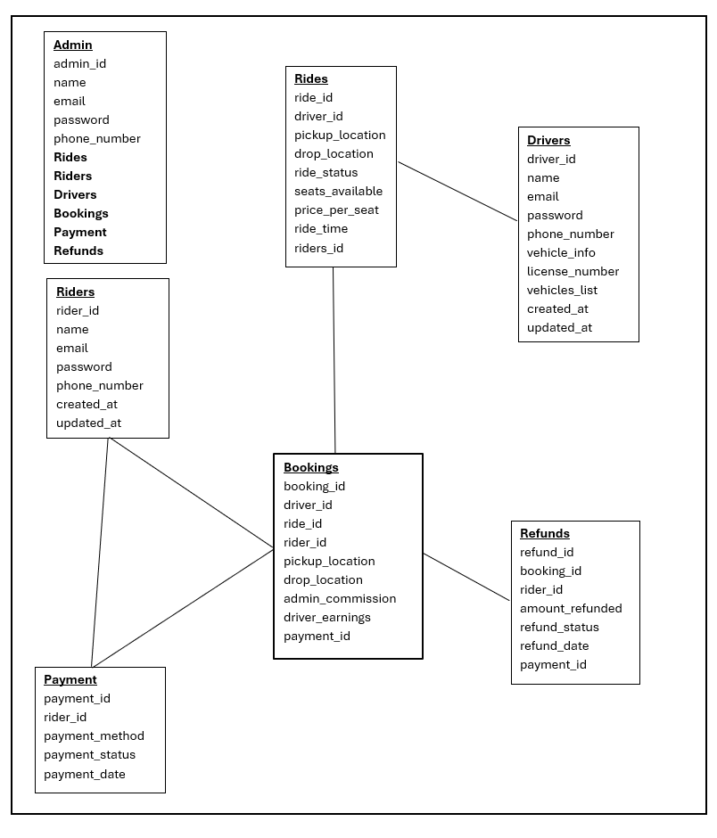
ER Diagram

Slide 8
Key Features and Functionalities
Admin Role:
Platform Oversight: Admins monitor the entire system, ensuring smooth operations and maintaining efficiency.
Financial Management: Admins oversee rider payments, distribute earnings between drivers and the platform, and earn a 20% commission per booking.
Dashboards: Comprehensive dashboards provide insights into ride statuses, payment histories, and system performance.

Slide 9
Driver Role
Rider Role
Registration: Drivers register with personal and vehicle details, including licensing and driving credentials.
Ride Management: Drivers create rides with specified details (pickup/drop-off locations, timings, seats, and prices).
Dashboard Access: Drivers track bookings, manage earnings, and monitor payment histories through personalized dashboards.
Cancellations: Drivers can cancel rides if needed, triggering the automated refund process for riders.
Registration and Booking: Riders register on the platform, search for rides within a 2-5 mile radius, and book seats.
Payment: Payments are securely processed via credit or debit cards. Riders access dashboards to manage bookings, track upcoming trips, and view payment histories.
Refunds: Riders are refunded based on cancellation timing if a driver cancels the ride.

Slide 10
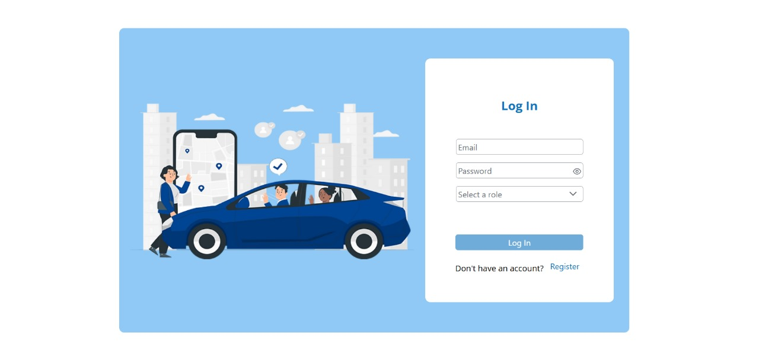
LOGIN PAGE

Slide 11
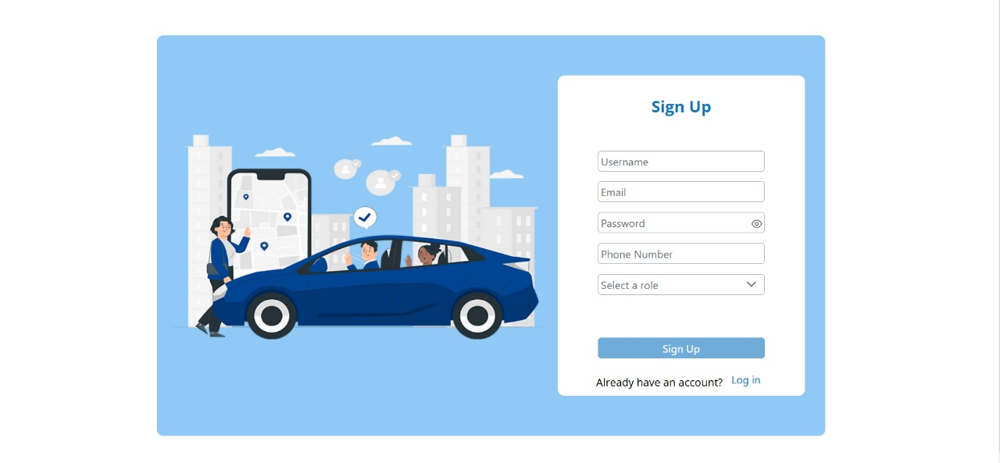
Signup / register page

Slide 12
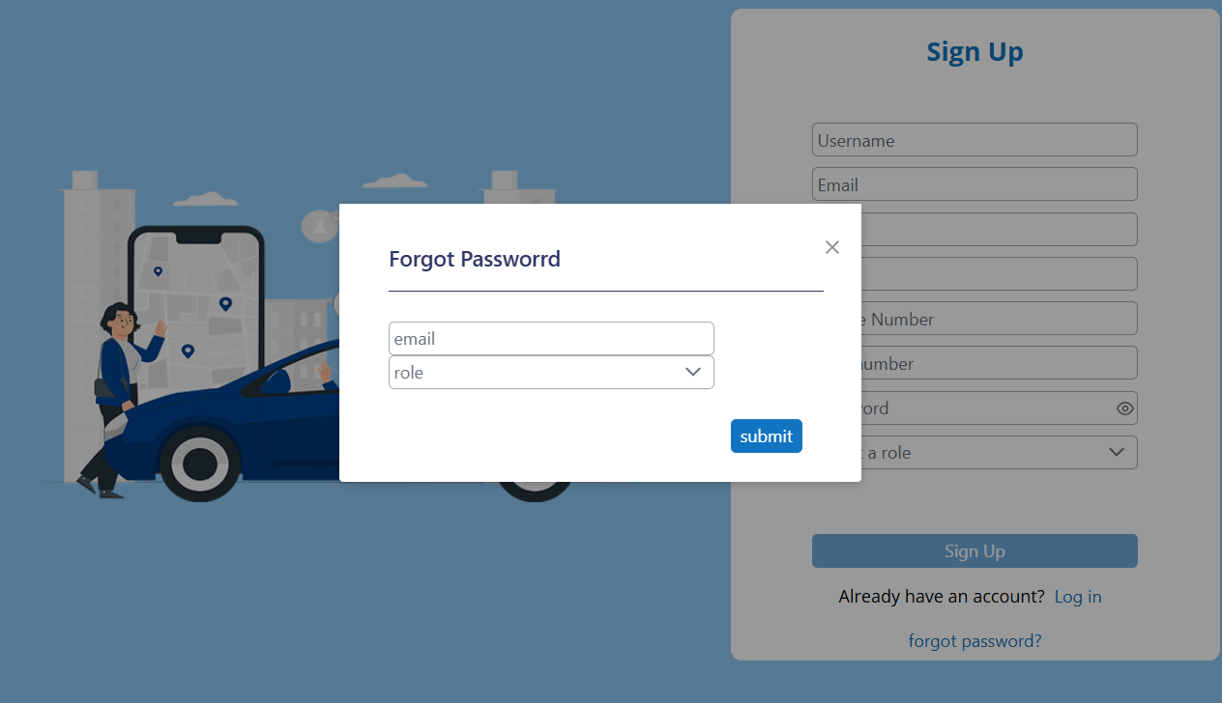
Forgot Password PAGE

Slide 13
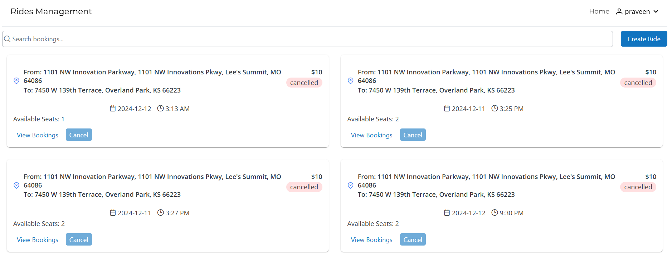
Driver Home PAGE

Slide 14
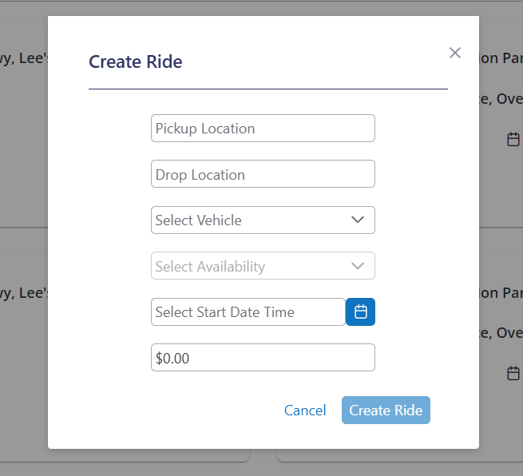
Create ride PAGE

Slide 15
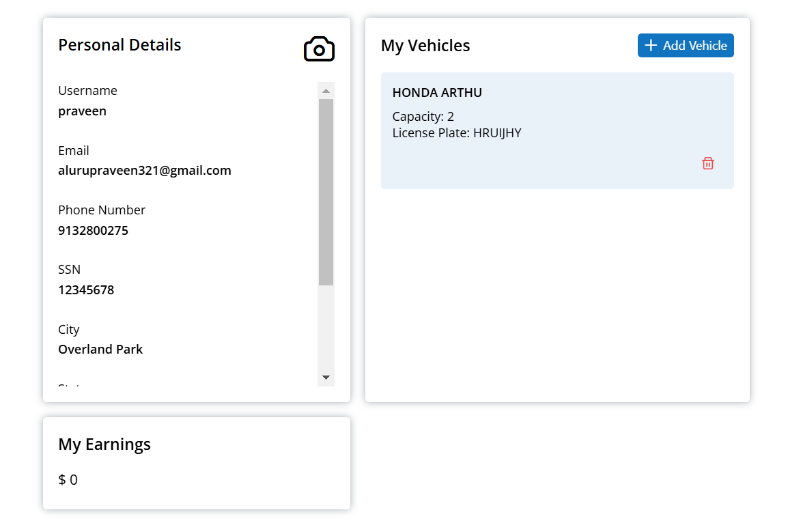
Driver profile page

Slide 16
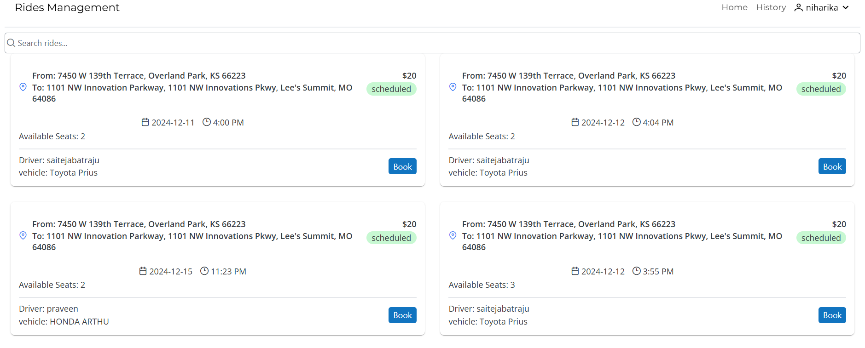
Rider Home PAGE

Slide 17
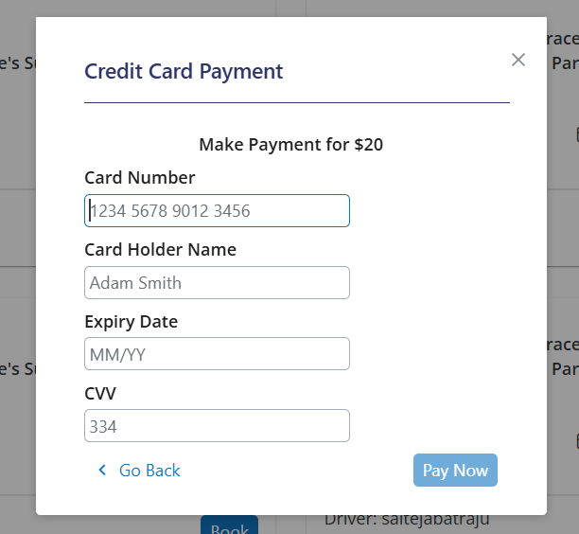
Payment PAGE

Slide 18
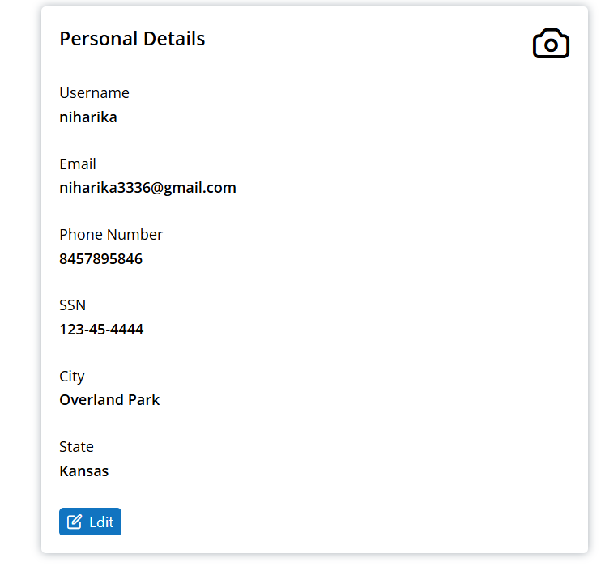
Rider Profile PAGE

Slide 19
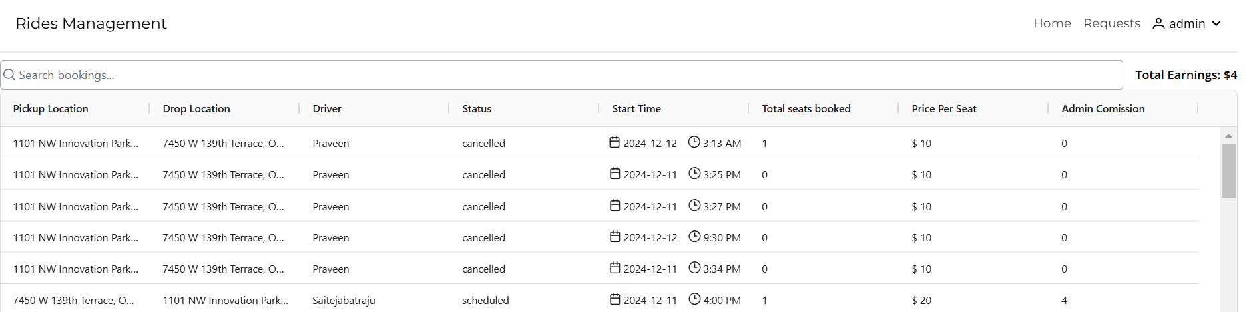
Admin Home PAGE

Slide 20
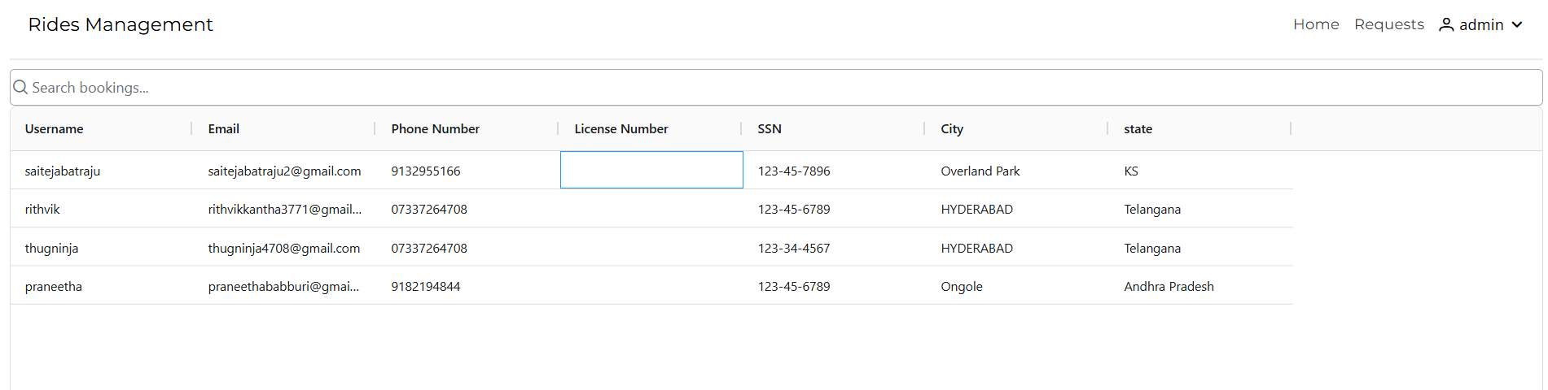
ADMIn Requests PAGE

Slide 21
THANK YOU

